Slide 1







Enterprise Blockchain Developers (Intermediate)
In support of
Powered By

Slide 2
Outline
Frontend Roadmap
Backend Roadmap
DevOps Roadmap
© 2017-2020 SmartMesh Foundation Pte. Ltd. | MeshBox Foundation Pte. Ltd.

Slide 3
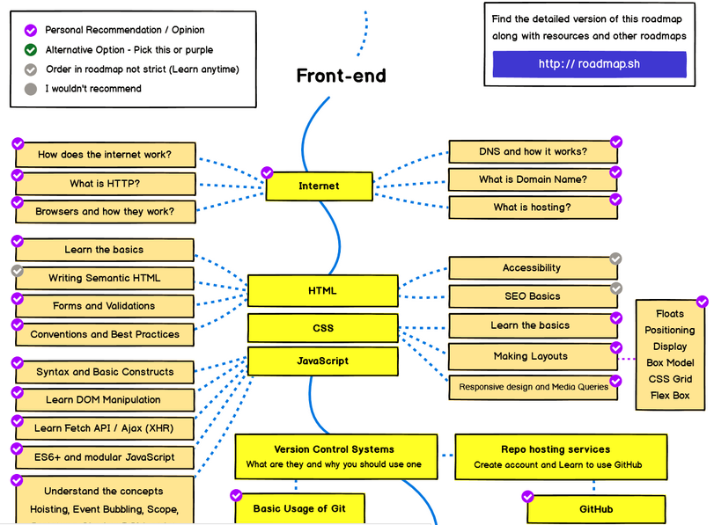
Frontend Roadmap 1

Slide 4
Firefox Demo
GET / POST request
GET: parameter is in url
https://www.skadden.com/professionals?skip=0&letter=A&hassearched=true
POST: parateter is in data
https://www.quora.com/
and headers
css demostration
© 2017-2020 SmartMesh Foundation Pte. Ltd. | MeshBox Foundation Pte. Ltd.

Slide 5
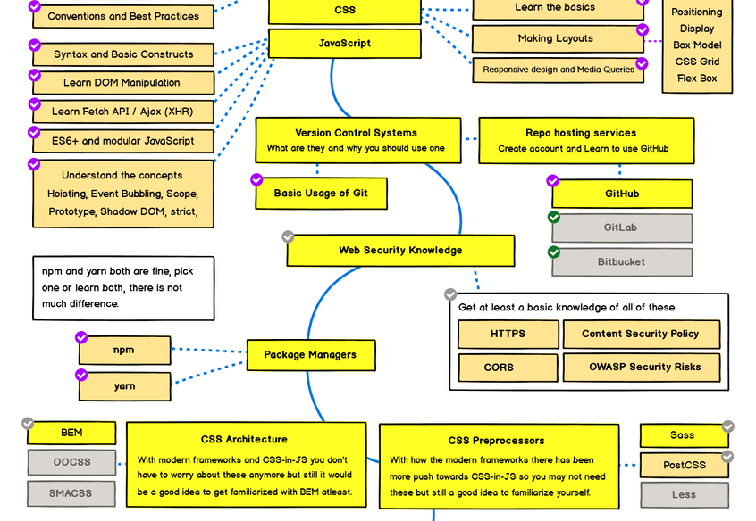
Frontend Roadmap 2

Slide 6
Github Demo
create a new repository
git add
git commit
git push
© 2017-2020 SmartMesh Foundation Pte. Ltd. | MeshBox Foundation Pte. Ltd.

Slide 7
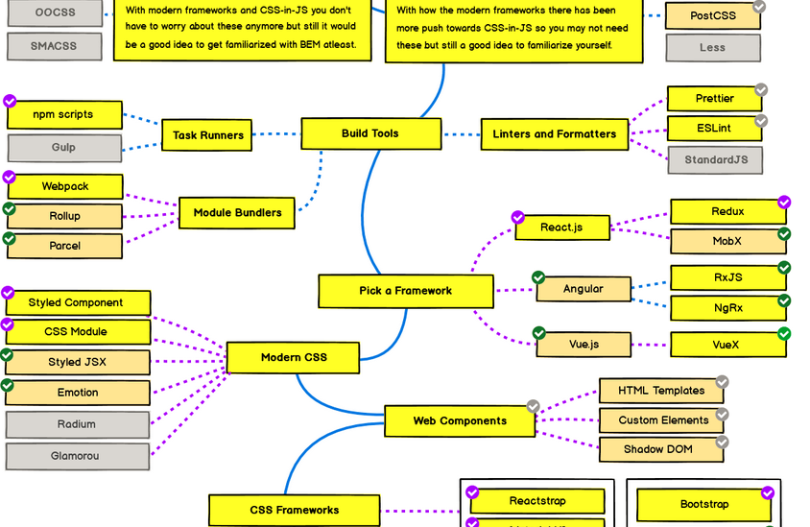
Frontend Roadmap 3

Slide 8
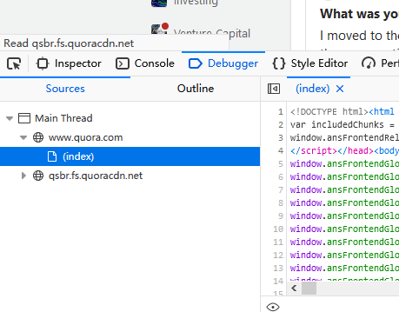
What is the frontend
Static JS HTML CSS files downloaded in the brower
Firefox demo: https://www.quora.com/
© 2017-2020 SmartMesh Foundation Pte. Ltd. | MeshBox Foundation Pte. Ltd.

Slide 9
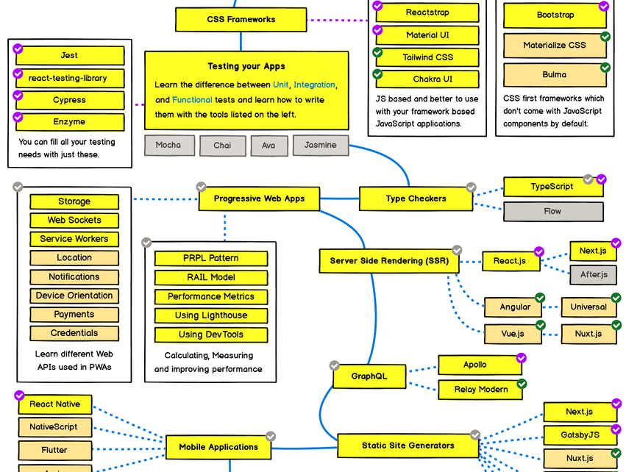
Frontend Roadmap 4

Slide 10
What is the frontend
Static JS HTML CSS files downloaded in the brower
Firefox demo: https://www.quora.com/
© 2017-2020 SmartMesh Foundation Pte. Ltd. | MeshBox Foundation Pte. Ltd.

Slide 11
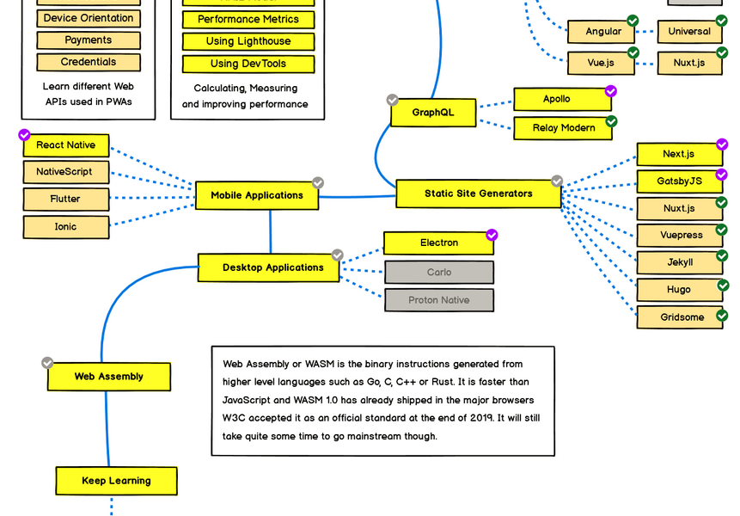
Frontend Roadmap 5

Slide 12
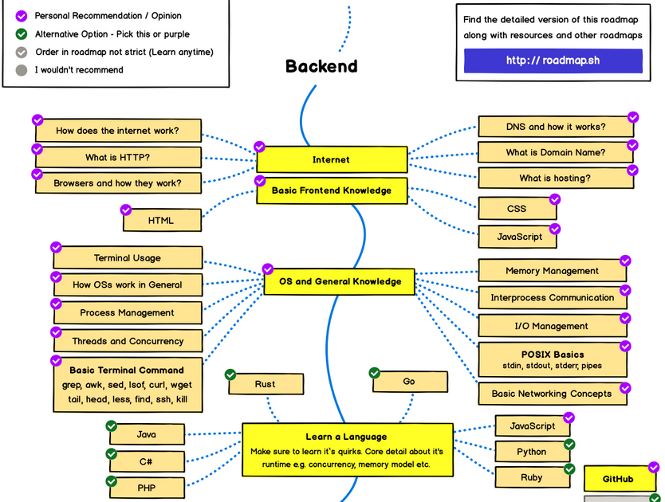
Backend Roadmap 1

Slide 13
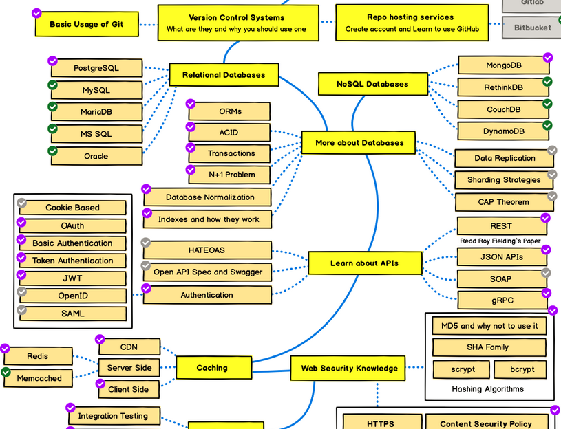
Backend Roadmap 2

Slide 14
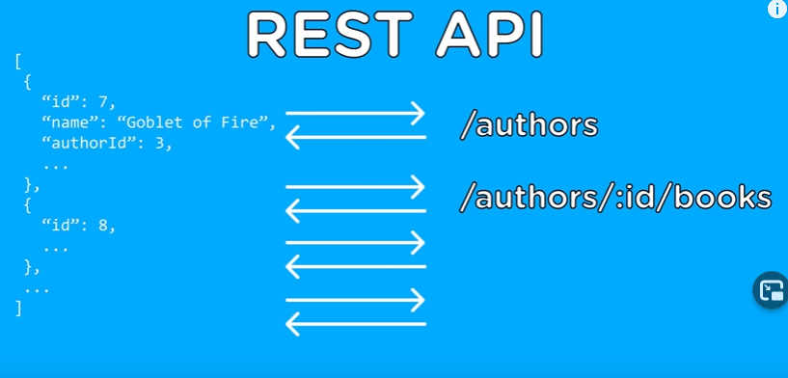
RestAPI
https://www.skadden.com/professionals?skip=0&letter=A&hassearched=true
change A to B
name -> id -> books
© 2017-2020 SmartMesh Foundation Pte. Ltd. | MeshBox Foundation Pte. Ltd.

Slide 15
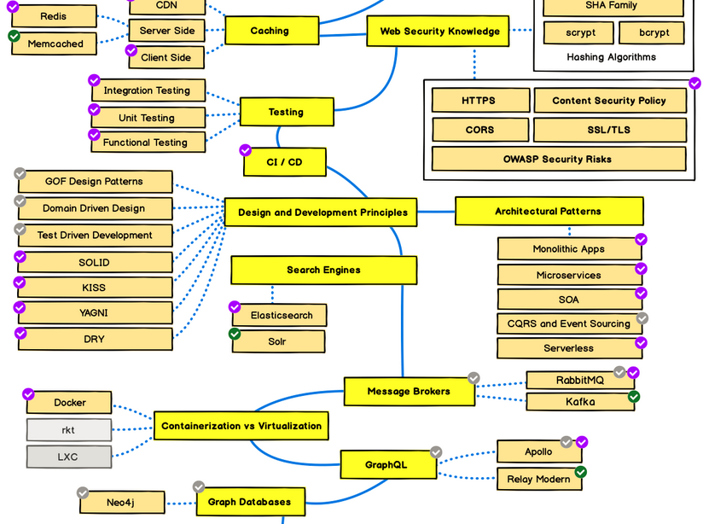
Backend Roadmap 3

Slide 16
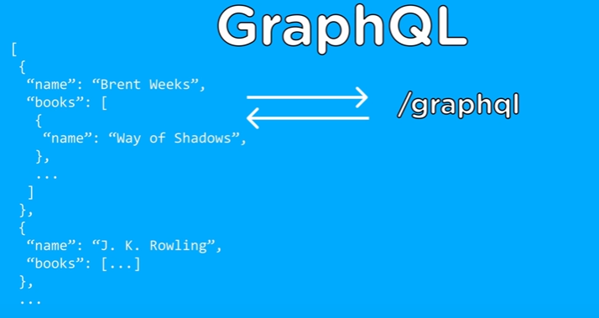
GraphQL
https://www.skadden.com/professionals?skip=0&letter=A&hassearched=true
change A to B
name -> id -> books
© 2017-2020 SmartMesh Foundation Pte. Ltd. | MeshBox Foundation Pte. Ltd.

Slide 17
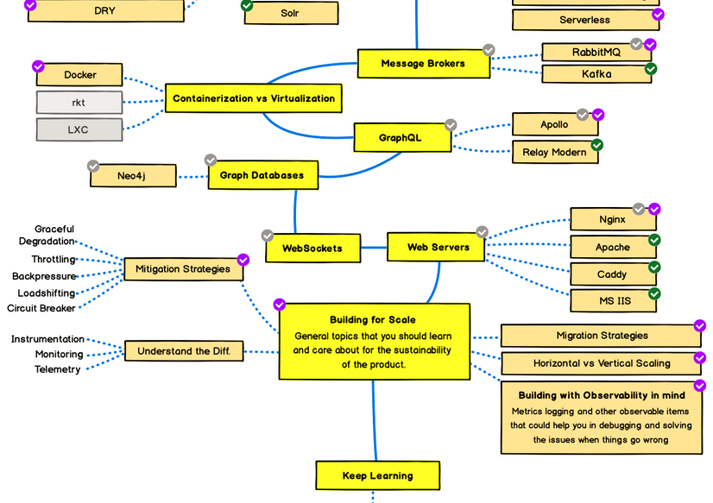
Backend Roadmap 4

Slide 18
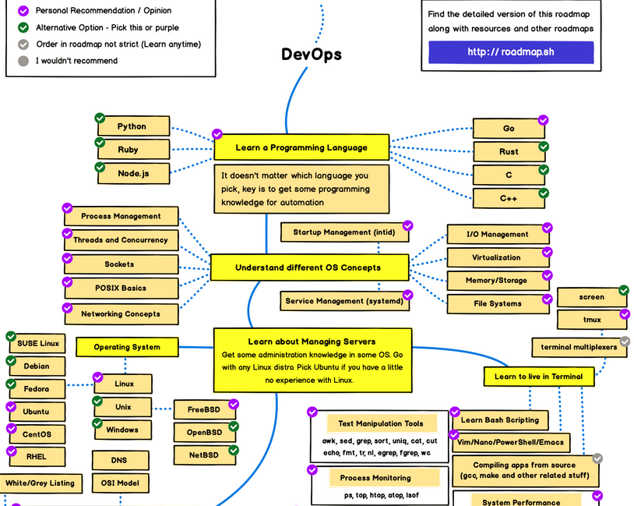
Devops Roadmap 1

Slide 19
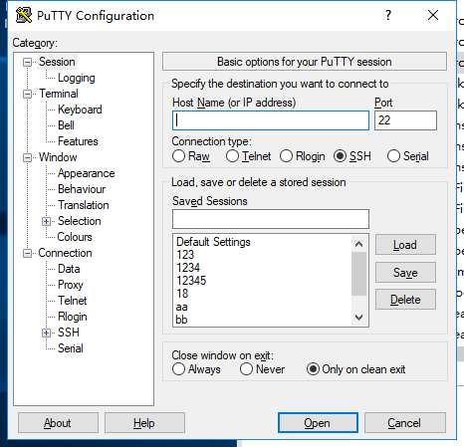
PUTTY / SSH
© 2017-2020 SmartMesh Foundation Pte. Ltd. | MeshBox Foundation Pte. Ltd.

Slide 20
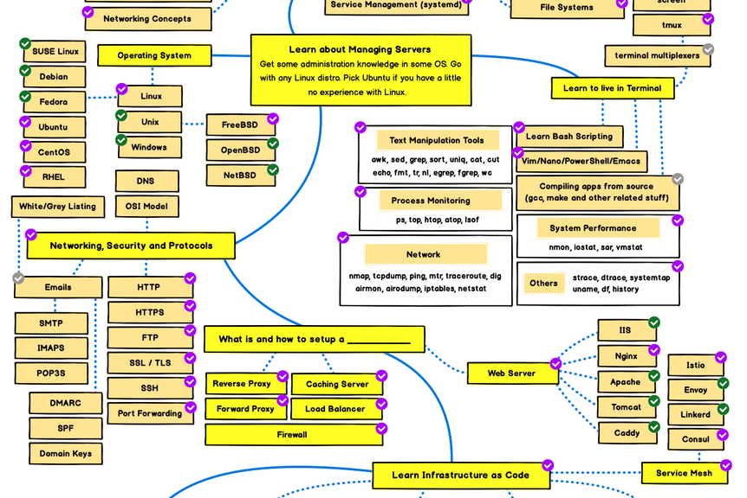
Devops Roadmap 2

Slide 21
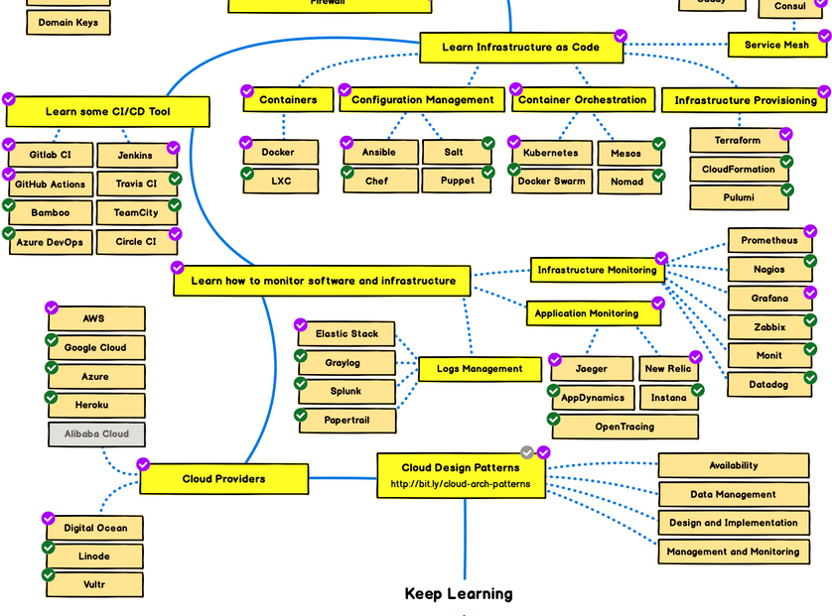
Devops Roadmap 3

